Slide 1
Object-Oriented Python
Chris Cooling
ECRI Senior Teaching Fellow

Slide 2
Important Information on Marking your Attendance on Inkpath
I will show you a QR code at the end of the session allowing you to mark your attendance on Inkpath. Please do not mark your attendance until then. If you are a Postgraduate Research student, this is required for receiving your ECRI professional development credit for this course.

Slide 3
Learning Outcomes
Define objects and classes in relation to Python
Use key object-oriented features of Python
Create classes tailored to the task they are to perform
Utilise object-oriented strategies to plan and develop research codes

Slide 4
Course Materials
The course materials are stored in a GitHub repository
Instructions for using the materials are found in the readme
Links to open the course notebooks in Colab are at the bottom of the readme
The materials can also be downloaded and run locally
You can also star/fork the repository

Slide 5
ReCoDE
The RCDS team has curated a collection of annotated exemplar projects known as ReCoDE
These demonstrate core research computing and data science principles applied to real problems
Accompanied by detailed descriptions of how they work, and the design decisions taken.
Object-Oriented Python exemplars:
Euler-Maruyama Method
Solving Stochastic Differential Equations
Organises the solver and various coefficients into classes
Includes inheritance and polymorphism
Incorporates Numpy and Matplotlib into the class structure
Notes:
Check Gotchas/gotchas.f90 for example of behaviour you might not expect.

Slide 6
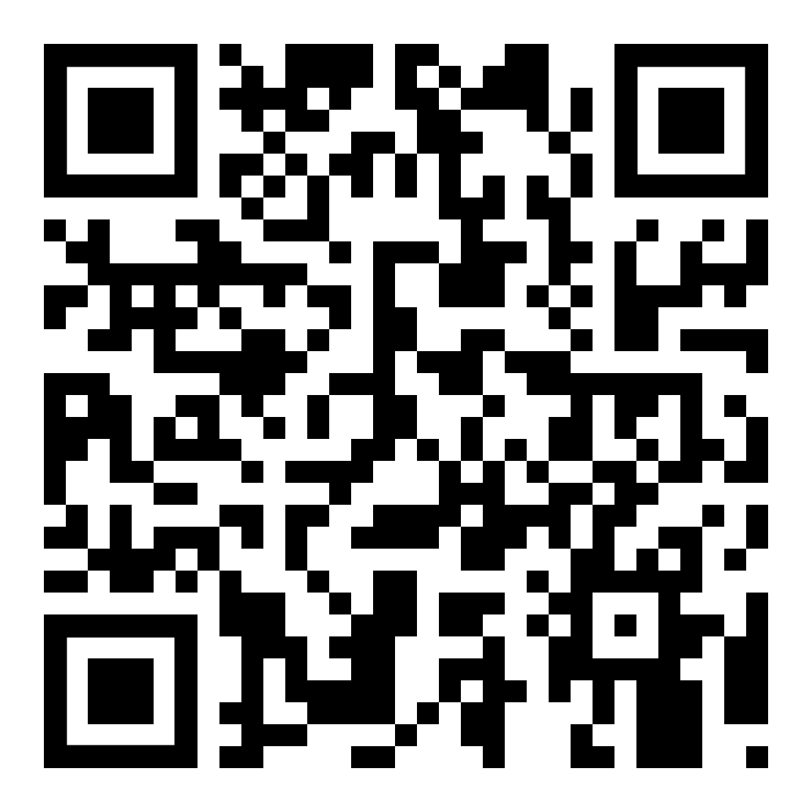
Please take 3 minutes to complete the evaluation
Once you’ve completed this course, please provide feedback
The link is https://ecri.short.gy/feedback-rcds
You should also have received an email with this link
This helps us improve the class for future students

Slide 7

PRES 2025
Coming in 2025 - PRES is a national survey for research degree students
Find out more about the action we have taken in response to the previous PRES:
Postgraduate Research Experience Survey (PRES) | Current students | Imperial College London
Presentation Title
DD/MM/YYYY
Notes:
Remove after PRES closes

Slide 8
Thank you
Presentation Title
DD/MM/YYYY

